Slide 1
Koforidua technical university faculty of applied science and technology computer science department
ONLINE HOTEL BOOKING SYSTEM
BY: KORANTENG AARON AYEH
ID: B207230030
25TH OCTOBER, 2025

Slide 2
BACKGROUND OF STUDY
The Need for Digital Booking in Ghana's Hotel Sector
Ghana's vital, growing tourism sector (31% of earnings) is hampered by manual, inefficient booking systems in many small-to-medium hotels, causing operational errors (e.g., double bookings) and failing to meet modern guest expectations for 24/7 online convenience.
Our Solution (Hotel Nexus)
Develop a user-friendly, Ghanaian-tailored online booking platform to provide real-time availability and secure, automated services, directly enhancing the competitiveness of the national tourism industry.

Slide 3
PROBLEM OF STATEMENT
Ghanaian hotels rely on outdated, manual booking systems, leading to high inefficiency and poor guest experience.
Inefficient, manual hotel operations in Ghana require a modern, 24/7 digital booking solution.
Current manual booking processes in Ghanaian hotels are failing both staff and guests.

Slide 4
OBJECTIVES OF THE SYSTEM
General Objective
To design and develop an online hotel booking system that streamlines room reservations, enhances customer convenience, and improves operational efficiency within the hospitality sector in Ghana.
Specific Objectives
Data Management: To design a system that stores information about available rooms and customer data.
Customer Booking: To develop a web-based booking platform enabling customers to search, book, and reserve hotel rooms.
Administrative Control: To Provide hotel administrators with a dashboard to manage room availability, reservations, and customer records.
Automated Communication: To Generate automated emails and SMS notifications for booking confirmations and cancellations

Slide 5
LITERATURE REVIEW
The Online Computerized Hotel Management System (HMS) provides comprehensive, centralized features like real-time reservations and automated billing, excelling in speed and 24/7 access but lacking modern payment integrations and multi-hotel scalability. The Hotel LaVilla system offers a web-based, customer-convenient platform with real-time checks to reduce overbooking, yet it also suffers from scalability limitations for multi-hotel use and its security depends heavily on correct payment implementation.

Slide 6
METHODOLOGY
The Agile Development Model, to ensure iterative design, testing, and improvement based on feedback. This model is chosen because it allows flexibility, quick adaptation to changes, and continuous engagement with stakeholders (hotel managers and customers) throughout the development process.

Slide 7
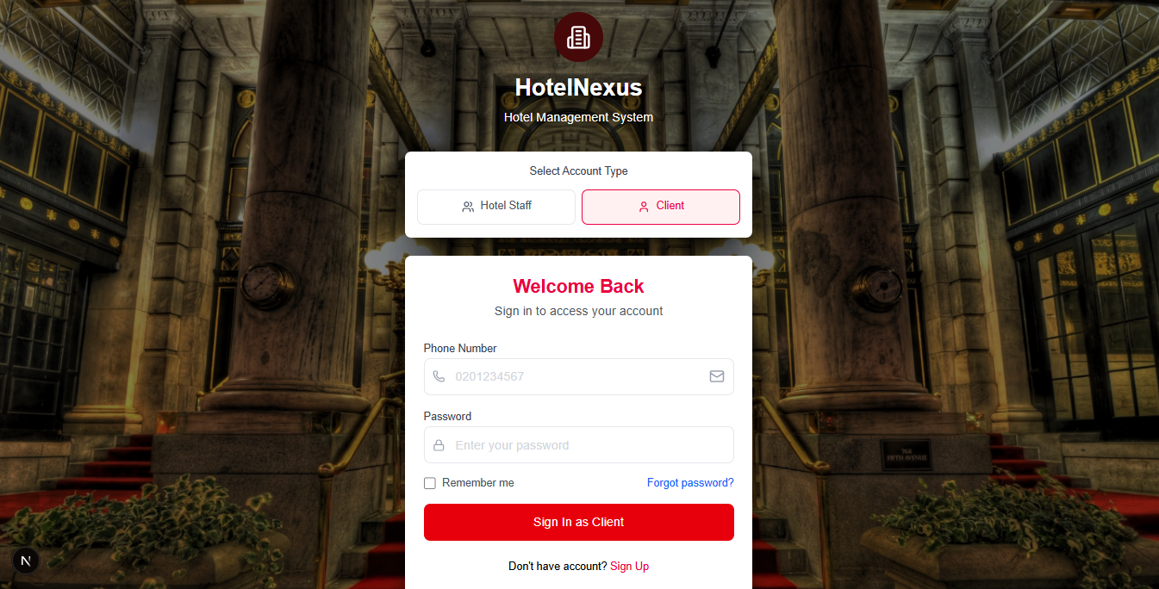
SYSTEM DEMONSTRATION

Slide 8
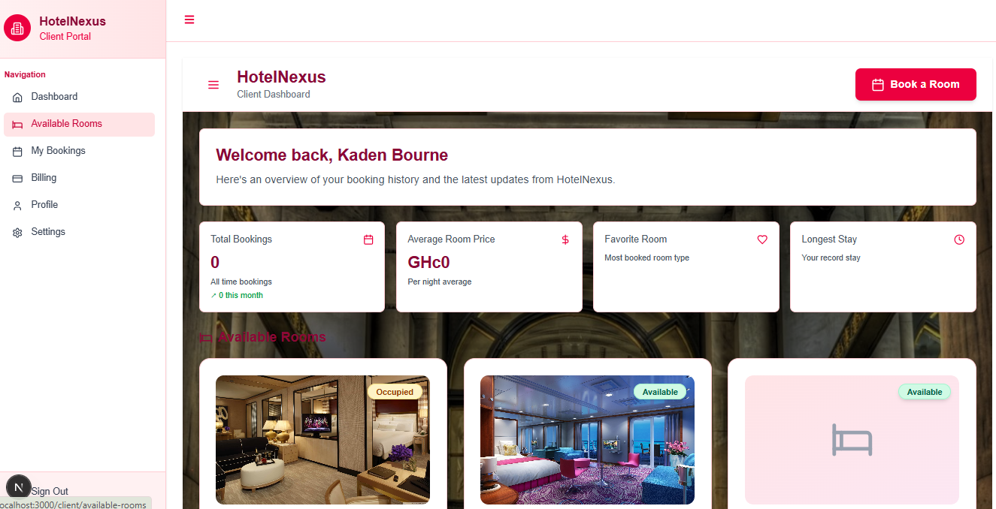
SYSTEM DEMONSTRATION

Slide 9
SYSTEM DEMONSTRATION
Login Into the system
System takes you to the dashboard
Book a room
Make payment
logout

Slide 10
CONCLUSIONS
Hotel Nexus successfully modernized hotel operations and improved the customer experience by automating the entire booking process. The platform provides guests with a superior, mobile-responsive interface for 24/7 access and ensures secure transactions. Administrators gain a centralized dashboard for data-driven management, giving hotels a competitive market advantage.

Slide 11
RECOMMENDATIONS
To Build a multi-hotel platform architecture that can easily support and grow with multiple properties.
To Integrate secure, multi-currency payment gateways supporting all major methods, including mobile money.
To Prioritize a mobile-first, responsive design to ensure 24/7, optimal accessibility for guests on any device.
To Provide a centralized admin dashboard for managing reservations, room inventory, and comprehensive analytics for data-driven decisions.
To Implement automated email and SMS notifications for instant booking confirmations, changes, and cancellations.

Slide 12
REFERENCES
Ogirima, S. A., Awode, T. R., & Adeosun, O. O. (2014). Online Computerized Hotel Management System. Department of Computer Science & Engineering, Ladoke Akintola University of Technology, Ogbomoso, Nigeria.
Prarthana. (2017). Online Hotel Booking System for Hotel LaVilla.
Measuring Customer Relationship Management in the Hospitality Industry of Some Selected Hotels in Accra. (2013). Research Paper, pp. 19-28.
Olifer, N., & Olifer, V. (2006). Computer Networks, Principles, Technologies and Protocol for Network Design. John Wiley and Sons Ltd, England
Ghana News Agency (GNA). (2023). Tourism Recovery and Expenditure Increase in Ghana.

